Slide 1
Chapter 4
Motion in Two Dimensions

Slide 2
Motion in two dimensions
Kinematic variables in one dimension
Position: x(t) m
Velocity: v(t) m/s
Acceleration: a(t) m/s²
Kinematic variables in three dimensions
Position: m
Velocity: m/s
Acceleration: m/s²
All are vectors: have direction and magnitudes
x
y
j
i
x
k
z

Slide 3
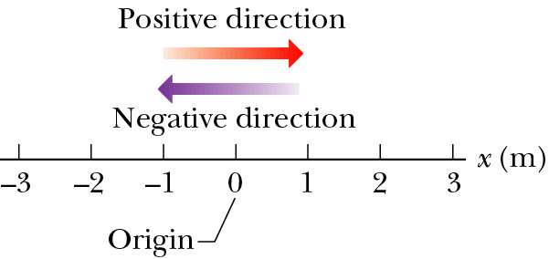
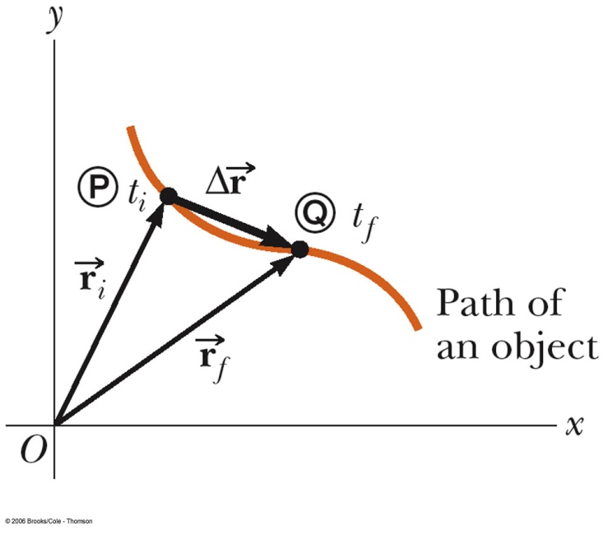
Position and Displacement
In one dimension
In two dimensions
Position: the position of an object is described by its position vector --always points to particle from origin.
Displacement:
x₁ (t₁) = - 3.0 m, x₂ (t₂) = + 1.0 m
Δx = +1.0 m + 3.0 m = +4.0 m

Slide 4
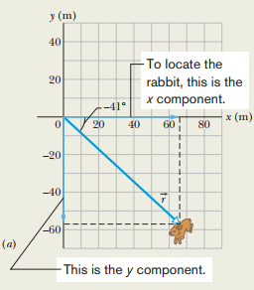
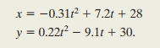
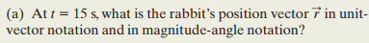
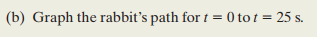
Sample Problem 4.01 Two-dimensional position vector, rabbit run
A rabbit runs across a parking lot on which a set of coordinate axes has, strangely enough, been drawn. The coordinates (meters) of the rabbit’s position as functions of time t (seconds) are given by

Slide 5
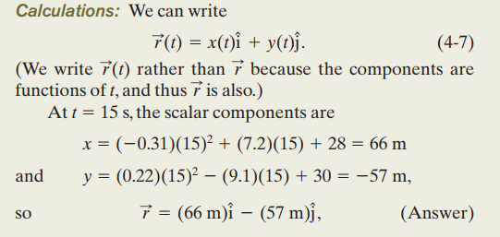
Solution: (a)

Slide 6
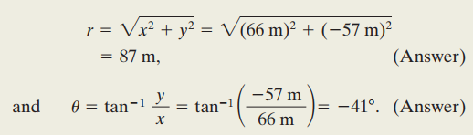
Solution:

Slide 7
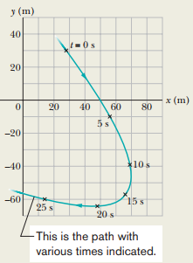
(b) Rabbit path Graph

Slide 8
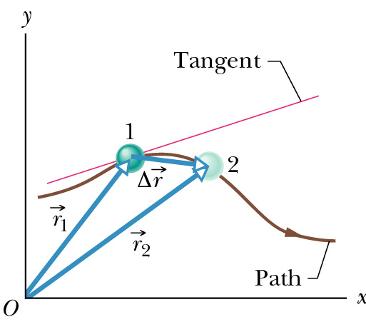
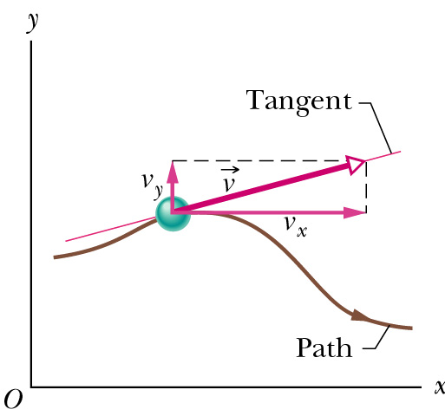
Average & Instantaneous Velocity
Average velocity
Instantaneous velocity
v is tangent to the path in x-y graph;

Slide 9
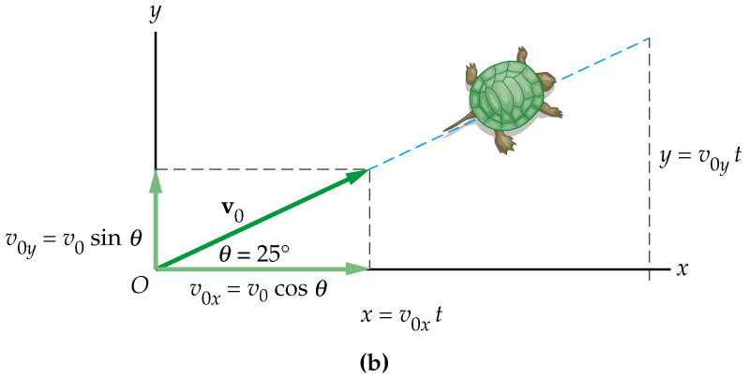
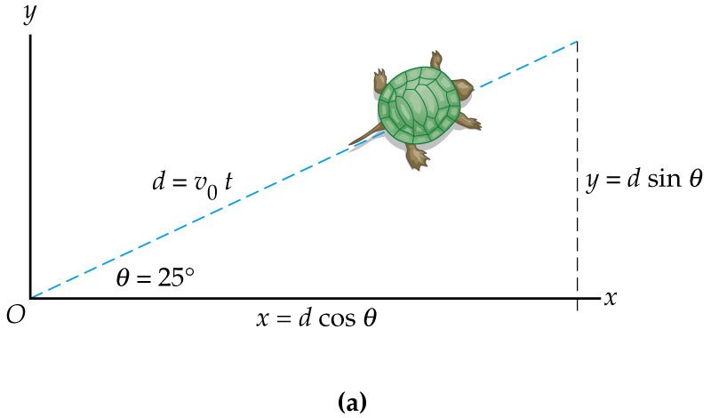
Motion of a Turtle
A turtle starts at the origin and moves with the speed of v₀=10 cm/s in the direction of 25° to the horizontal.
(a) Find the coordinates of a turtle 10 seconds later.
(b) How far did the turtle walk in 10 seconds?

Slide 10
Motion of a Turtle
Notice, you can solve the equations independently for the horizontal (x) and vertical (y) components of motion and then combine them!
X components:
Y components:
Distance from the origin:

Slide 11
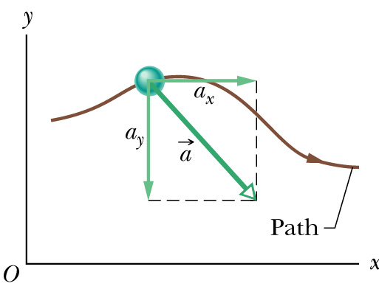
Average & Instantaneous Acceleration
Average acceleration
Instantaneous acceleration
The magnitude of the velocity (the speed) can change
The direction of the velocity can change, even though the magnitude is constant
Both the magnitude and the direction can change
Notes:
The average acceleration is defined as the rate at which the velocity changes. The instantaneous acceleration is the limit of the average acceleration as Δt approaches zero

Slide 12
Summary in two dimension
Position
Average velocity
Instantaneous velocity
Acceleration
are not necessarily same direction.

Slide 13
Motion in two dimensions
Motions in each dimension are independent components
Constant acceleration equations
Constant acceleration equations hold in each dimension
t = 0 beginning of the process;
where a_{x} and a_{y} are constant;
Initial velocity initial displacement ;

Slide 14
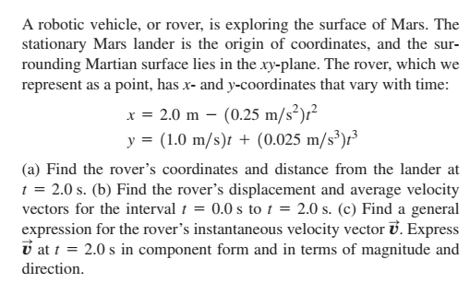
Example 3.1 Taken from University Physics

Slide 15
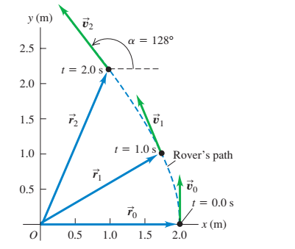
Example 3.1 Taken from University Physics

Slide 16
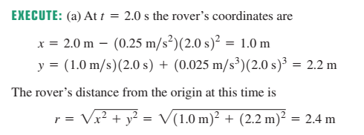
Example 3.1 Taken from University Physics

Slide 17
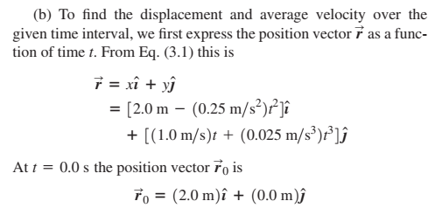
Example 3.1 Taken from University Physics
Example 3.1 Taken from University Physics

Slide 18
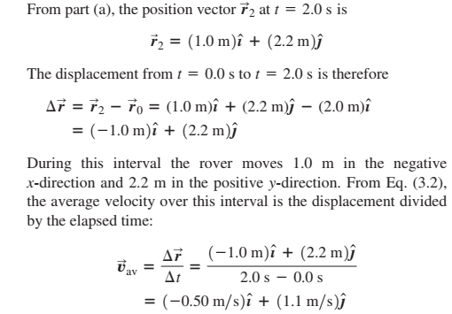
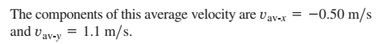
Example 3.1 Taken from University Physics

Slide 19
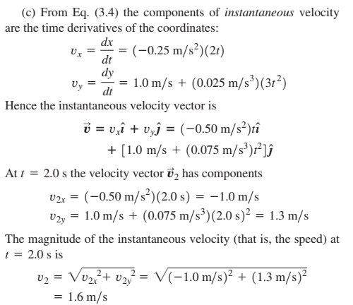
Example 3.1 Taken from University Physics

Slide 20
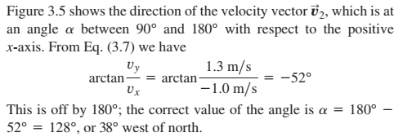
Example 3.1 Taken from University Physics

Slide 21
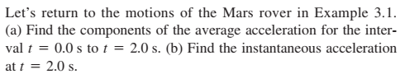
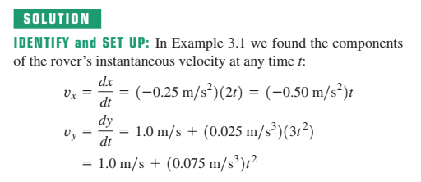
Example 3.2 Calculating Average and Instantaneous Acceleration

Slide 22
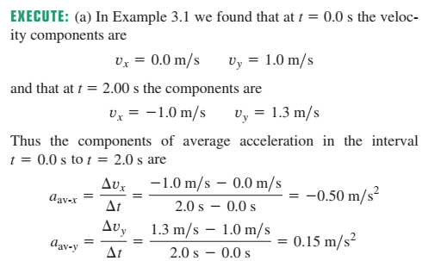
Example 3.2 Calculating Average and Instantaneous Acceleration

Slide 23
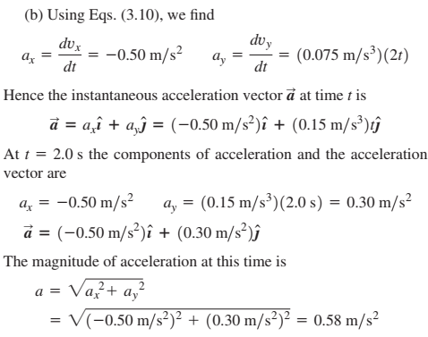

Slide 24
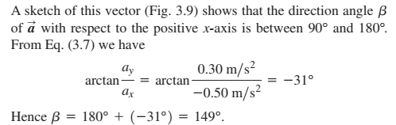
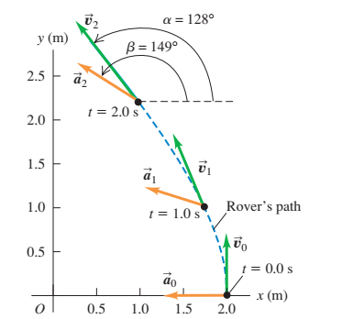

Slide 25
Projectile Motion
A projectile is an object moving in two dimensions under the influence of Earth's gravity; its path is a parabola.

Slide 26
Projectile Motion
It can be understood by analyzing the horizontal and vertical motions separately.

Slide 27
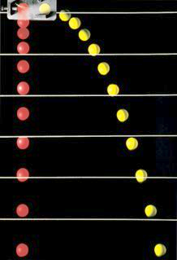
Projectile Motion
2-D problem and define a coordinate system: x- horizontal, y- vertical (up +)
Try to pick x_{i} = 0, y_{i} = 0 at t = 0
Horizontal motion + Vertical motion
Horizontal: a_{x} = 0 , constant velocity motion
Vertical: a_{y} = -g = -9.8 m/s², v_{iy} = 0
Equations:
Horizontal Vertical

Slide 28
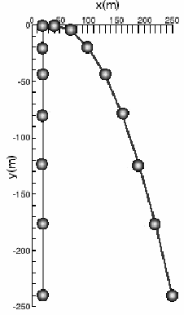
Projectile Motion
X and Y motions happen independently, so we can treat them separately
Try to pick x_{i} = 0, y_{i} = 0 at t = 0
Horizontal motion + Vertical motion
Horizontal: a_{x} = 0 , constant velocity motion
Vertical: a_{y} = -g = -9.8 m/s²
x and y are connected by time t
y(x) is a parabola
Horizontal Vertical

Slide 29
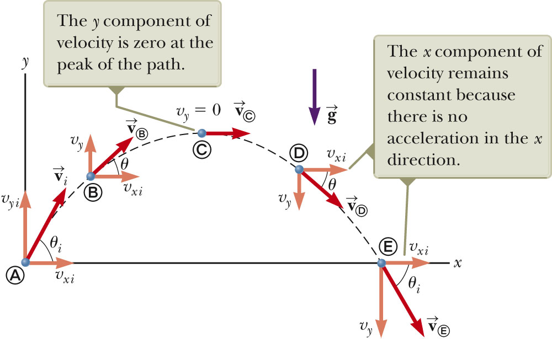
Trajectory of Projectile Motion
Initial conditions (t = 0): x_{i} = 0, y_{i} = 0 v_{ix} = v_{i} cosθ₀ and v_{iy} = v_{i} sinθ₀
Horizontal motion:
Vertical motion:
Parabola

Slide 30
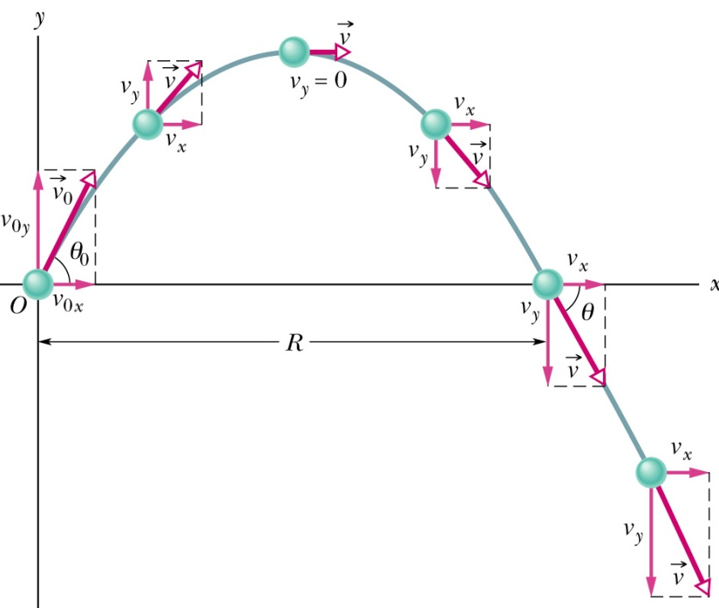
What is R and h ?
Initial conditions (t = 0): x_{i} = 0, y_{i} = 0 v_{ix} = v_{i} cosθ₀ and v_{ix} = v_{i} sinθ₀, then
h
Horizontal Vertical

Slide 31
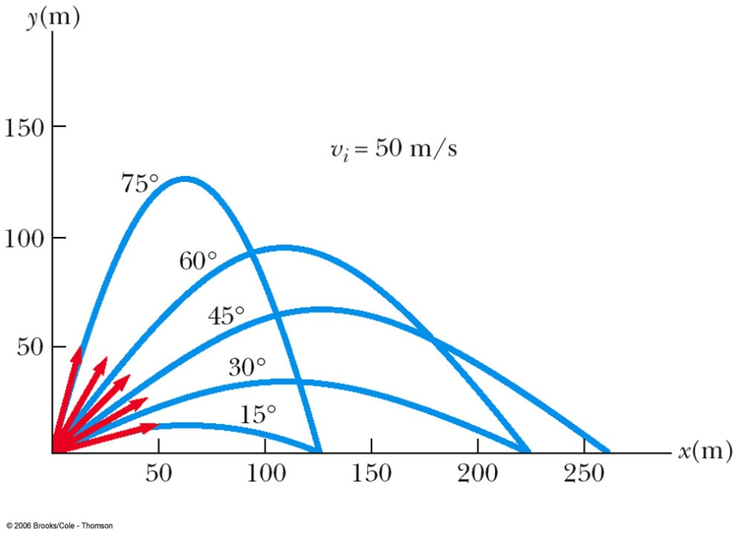
Projectile Motion at Various Initial Angles
Complementary values of the initial angle result in the same range
The heights will be different
The maximum range occurs at a projection angle of 45º

Slide 32
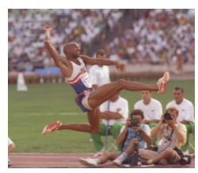
Example 4.2: The long Jump
A long jumper leaves the ground at an angle of 20⁰ above the horizontal and at a speed of 11.0 m/s.
How far does he jump in the horizontal direction?
What is the maximum height reached?
Section 4.3

Slide 33
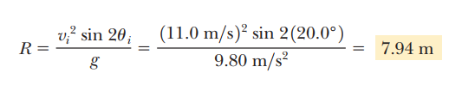
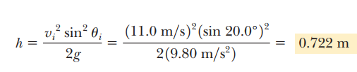
Solution:

Slide 34
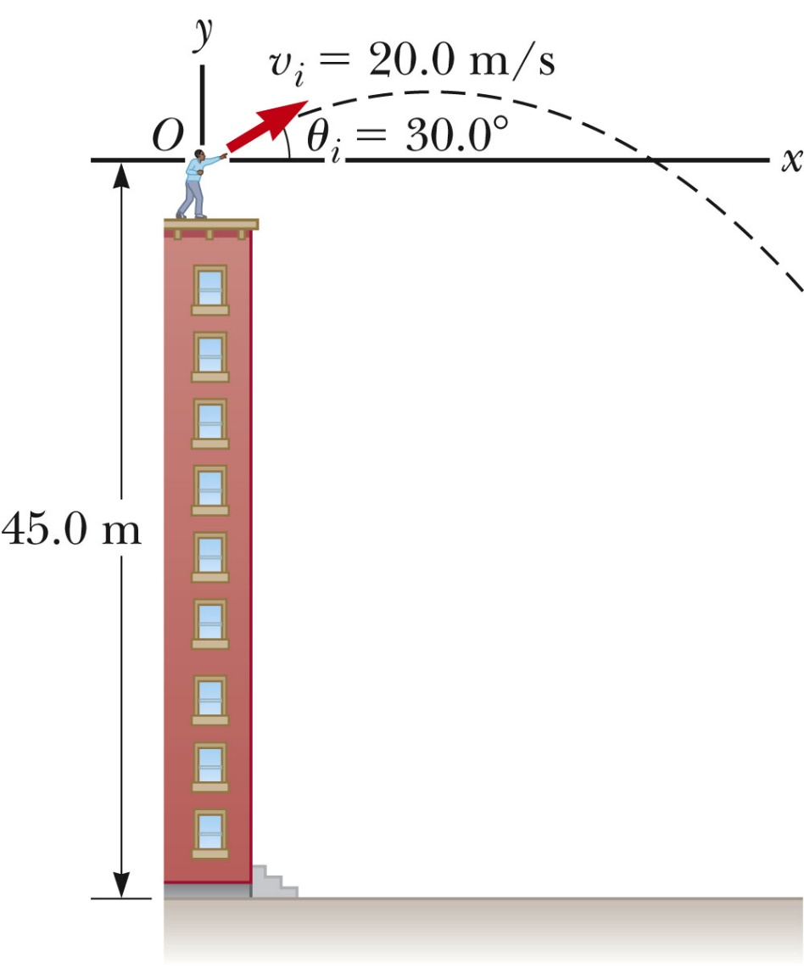
Example 4.4: Non-Symmetric Projectile Motion
A stone is thrown from the top of a building upward at an angle of 30.0°to the horizontal with an initial speed of 20.0 m/s as shown in Figure. The height of the building is 45.0 m.
(A) How long does it take the stone to reach the ground?
(B) What is the speed of the stone just before it strikes the ground?
Section 4.3

Slide 35
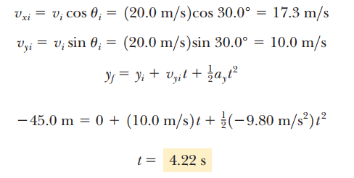
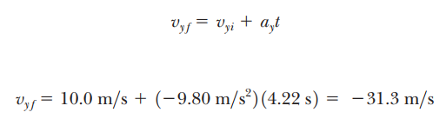
Solution

Slide 36
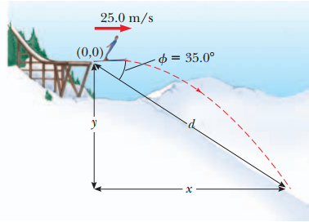
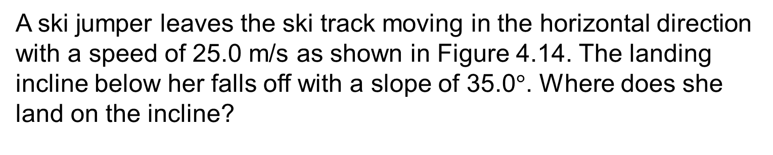
Problem 4.5:
A ski jumper leaves the ski track moving in the horizontal direction with a speed of 25.0 m/s as shown in Figure 4.14. The landing incline below her falls off with a slope of 35.0$°$. Where does she land on the incline?

Slide 37
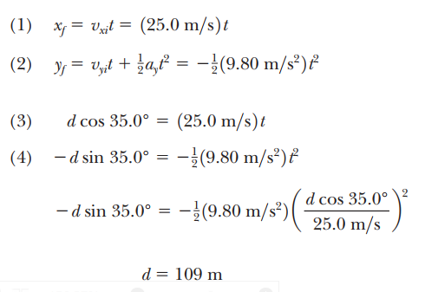
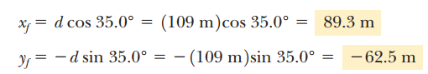
Solution:

Slide 38
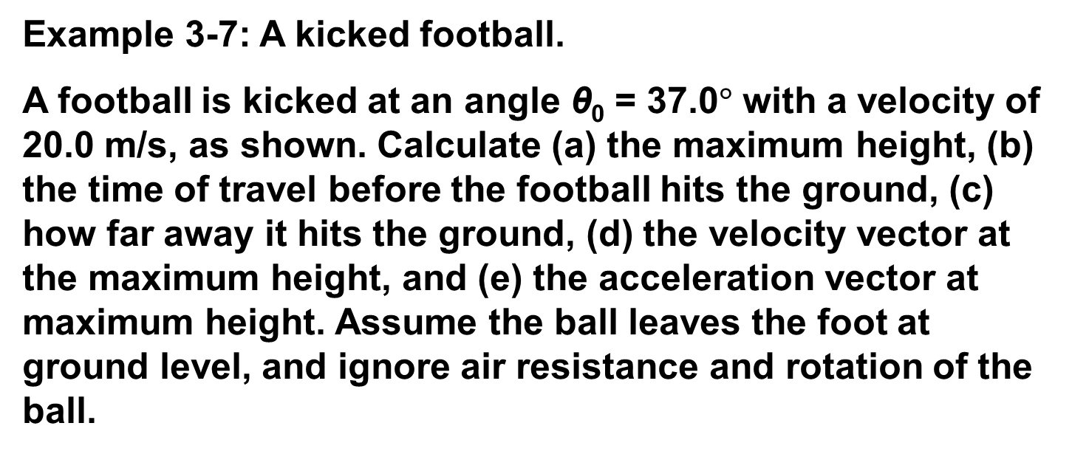
Solving Problems Involving Projectile Motion
Example 3-7: A kicked football.
A football is kicked at an angle θ₀ = 37.0$°$ with a velocity of 20.0 m/s, as shown. Calculate (a) the maximum height, (b) the time of travel before the football hits the ground, (c) how far away it hits the ground, (d) the velocity vector at the maximum height, and (e) the acceleration vector at maximum height. Assume the ball leaves the foot at ground level, and ignore air resistance and rotation of the ball.

Slide 39
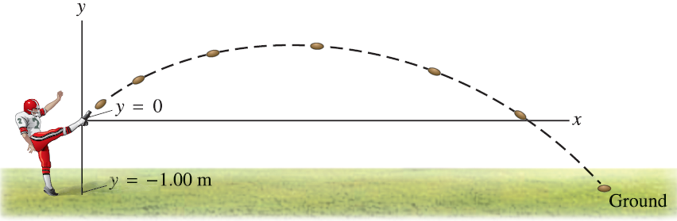
Solving Problems Involving Projectile Motion
Example 3-11: A punt.
Suppose the football in Example 3–7 was punted and left the punter’s foot at a height of 1.00 m above the ground. How far did the football travel before hitting the ground? Set x₀ = 0, y₀ = 0.

Slide 40
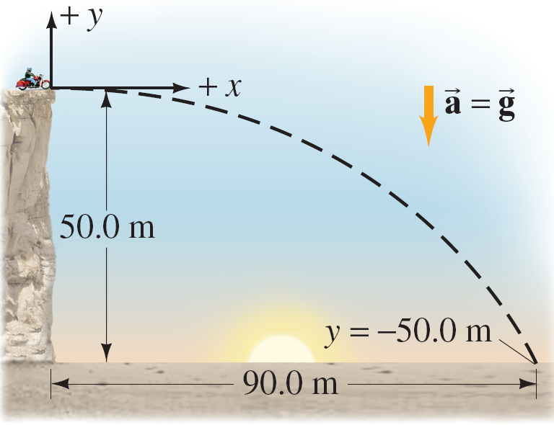
Projectile Motion
Example 3-6: Driving off a cliff.
A movie stunt driver on a motorcycle speeds horizontally off a 50.0-m-high cliff. How fast must the motorcycle leave the cliff top to land on level ground below, 90.0 m from the base of the cliff where the cameras are? Ignore air resistance.

Slide 41
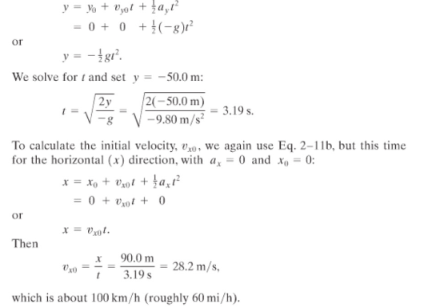
Solution:

Slide 42
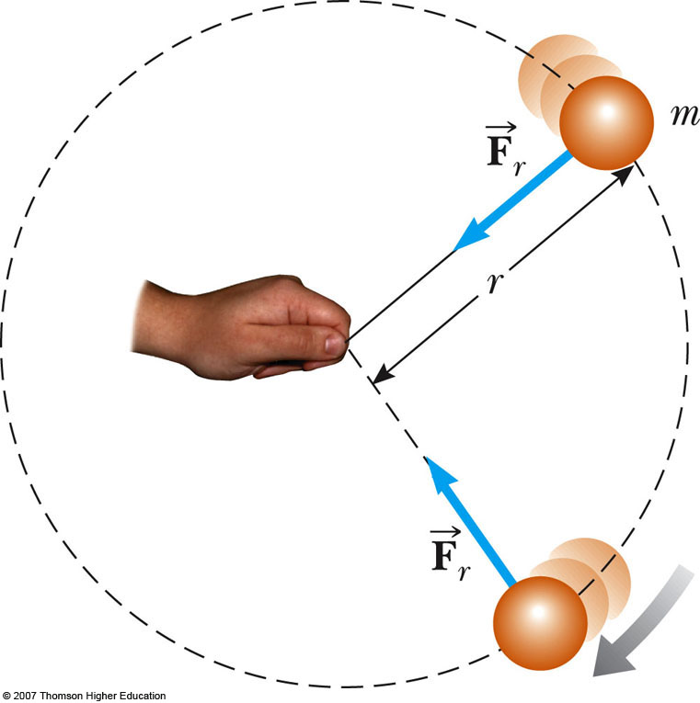
Uniform Circular Motion
Uniform circular motion
Constant speed, or,
constant magnitude of velocity
Motion along a circle:
Changing direction of velocity
Notes:
An object traveling in a circle, even though it moves with a constant speed, will have an acceleration
The centripetal acceleration is due to the change in the direction of the velocity

Slide 43
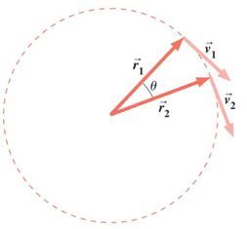
Uniform Circular Motion
Uniform circular motion occurs when an object moves in a circular path with a constant speed.
An acceleration exists since the direction of the motion is changing .
This change in velocity is related to an acceleration.

Slide 44
Uniform Circular Motion
Centripetal acceleration
Similar triangle
Direction: Centripetal
v_{i}
Δv = v_{f} - v_{i}
v_{f}
v_{i}
y
A
B
v_{f}
Δr
R
r_{i}
r_{f}
O
x

Slide 45
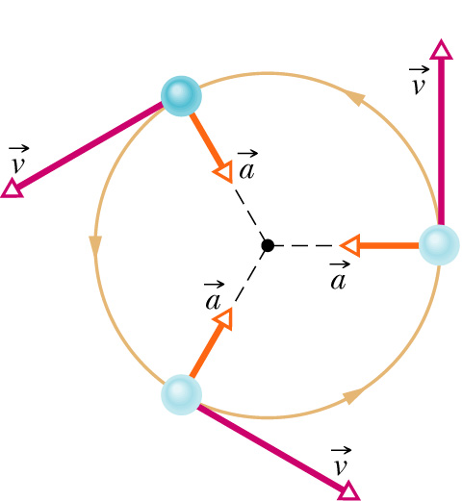
Uniform Circular Motion
Velocity:
Magnitude: constant v
The direction of the velocity is tangent to the circle
Acceleration:
Magnitude:
directed toward the center of the circle of motion
Period:
time interval required for one complete revolution of the particle

Slide 46
Problem. Engineering a Road
Consider a flat, horizontal road with 80 km/h (22.2 m/s) speed limit. If the max vehicle acceleration is 1.5 m/s²,
what’s the min safe radius for curves on this road.

Slide 47
3.11 Centripetal acceleration on a curved road (University Physics)
An Aston Martin V8 Vantage sports car has a “lateral acceleration” of 0.96g = (0.96)(9.8 m/s²) This is the maximum centripetal acceleration the car can sustain without skidding out of a curved path. If the car is traveling at a constant 40 m/s (about 89 mi/h) or 144 km/h ) on level ground, what is the radius R of the tightest unbanked curve it can negotiate?

Slide 48

Solution:

Slide 49

Tangential Acceleration and Radial Acceleration
The magnitude of the velocity could also be changing.
In this case, there would be a tangential acceleration.
The motion would be under the influence of both tangential and centripetal accelerations.
Note the changing acceleration vectors

Slide 50


Slide 51
Total Acceleration
The tangential acceleration causes the change in the speed of the particle.
The radial acceleration comes from a change in the direction of the velocity vector.
Section 4.5

Slide 52
Total Acceleration, equations
The tangential acceleration:
The radial acceleration:
Total acceleration:
Section 4.5

Slide 53

Problem 4.7: Over the rise
A car exhibits a constant acceleration of 0.300 m/s² parallel to the roadway. The car passes over a rise in the roadway such that the top of the rise is shaped like a circle of radius 500 m. At the moment the car is at the top of the rise, its velocity vector is horizontal and has a magnitude of 6.00 m/s. What are the magnitude and direction of the total acceleration vector for the car at this
instant?

Slide 54
Relative Velocity and Relative acceleration
Two observers moving relative to each other generally do not agree on the outcome of an experiment.
However, the observations seen by each are related to one another.
A frame of reference can described by a Cartesian coordinate system for which an observer is at rest with respect to the origin.
Relative velocity is all about relating the measurements of two different observers, one moving with respect to the other

Slide 55

Different Measurements, example
Observer A measures point P at +5 m from the origin
Observer B measures point P at +10 m from the origin
The difference is due to the different frames of reference being used.
Section 4.6

Slide 56

Different Measurements, another example
The man is walking on the moving beltway.
The woman on the beltway sees the man walking at his normal walking speed.
The stationary woman sees the man walking at a much higher speed.
The combination of the speed of the beltway and the walking.
The difference is due to the relative velocity of their frames of reference.
Section 4.6

Slide 57

Relative Velocity, generalized
Reference frame S_{A} is stationary
Reference frame S_{B} is moving to the right relative to S_{A} at
This also means that S_{A} moves at – relative to S_{B}
Define time t = 0 as that time when the origins coincide

Slide 58

Notation
The first subscript represents what is being observed.
The second subscript represents who is doing the observing.
Example
The velocity of B (and attached to frame S_{B}) as measured by observer A

Slide 59
Relative Velocity, equations
The positions as seen from the two reference frames are related through the velocity
The derivative of the position equation will give the velocity equation
is the velocity of the particle P measured by observer A
is the velocity of the particle P measured by observer B
These are called the Galilean transformation equations.
Section 4.6

Slide 60
Acceleration in Different Frames of Reference
The derivative of the velocity equation will give the acceleration equation.
The acceleration of the particle measured by an observer in one frame of reference is the same as that measured by any other observer moving at a constant velocity relative to the first frame.
Since
Therefore,

Slide 61

Relative Velocity
Here, v_{WS} is the velocity of the water in the shore frame, v_{BS} is the velocity of the boat in the shore frame, and v_{BW} is the velocity of the boat in the water frame.
The relationship between the three velocities is:

Slide 62


Example 4-8: A Boat Crossing a River
A boat crossing a wide river moves with a speed of (${\vec{V}}_{br}$= 10.0 km/h) relative to the water. The water in the river has a uniform speed of (${\vec{V}}_{rE}$= 5.00 km/h) due east relative to the Earth.
(A) If the boat heads due north, determine the velocity of the boat relative to an observer standing on either bank.

Slide 63


Solution:
We know ${\vec{V}}_{br}$, the velocity of boat relative to river, and ${\vec{V}}_{rE}$, the velocity of river relative to earth. What we have to find is ${\vec{V}}_{bE}$,the velocity of boat relative to earth. The relationship between these three quantities is given as
$${\vec{V}}_{bE}={\vec{V}}_{br}+{\vec{V}}_{rE}$$

Slide 64


Relative Velocity
Example 3-15: Heading across the river.
(B) If the boat travels with the same speed of (${\vec{V}}_{br}$=10.0 km/h) relative to the river and is to travel due north as shown in Figure 4.21b, what should its heading be?

Slide 65


Finalize The boat must head upstream so as to travel directly northward across the river. For the given situation, the boat must steer a course 30.0$°$ west of north. For faster currents, the boat must be aimed upstream at larger angles.

Slide 66



Slide 67



Solution:

